Slide 1
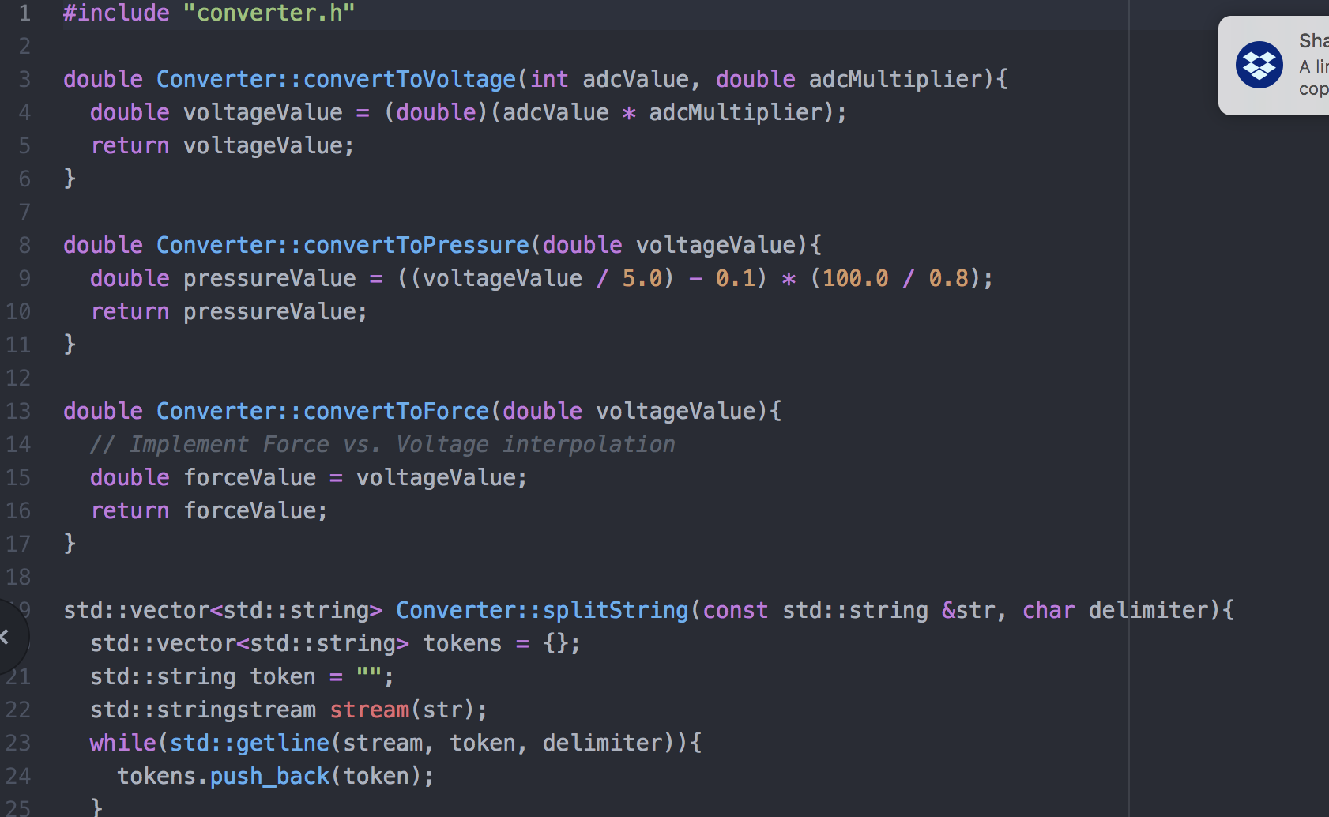
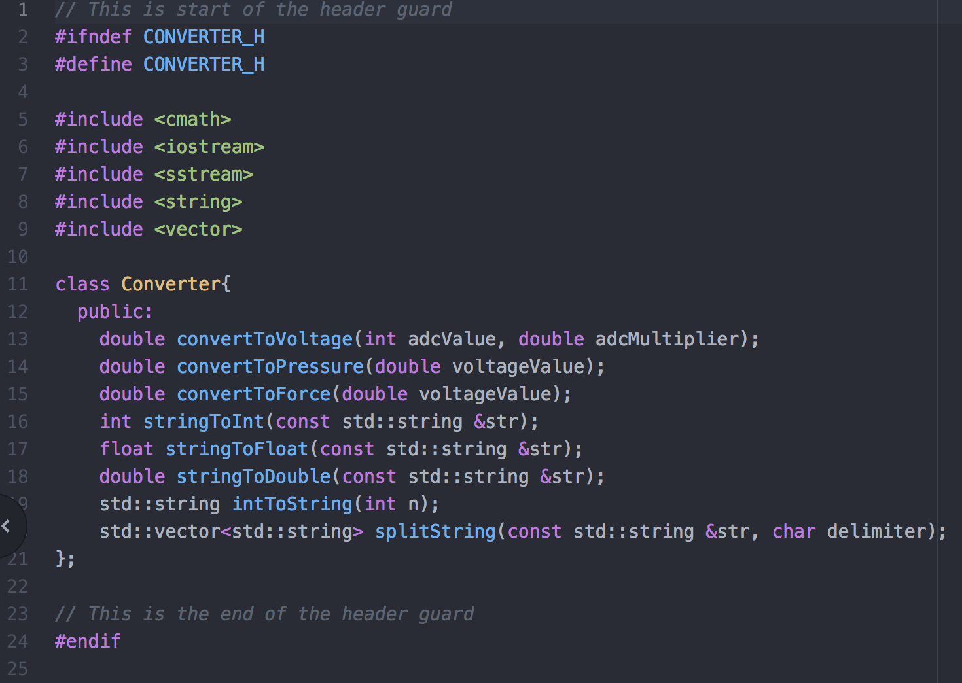
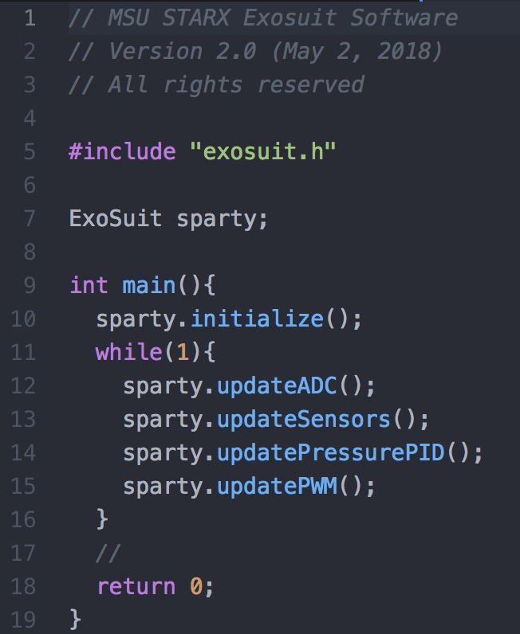
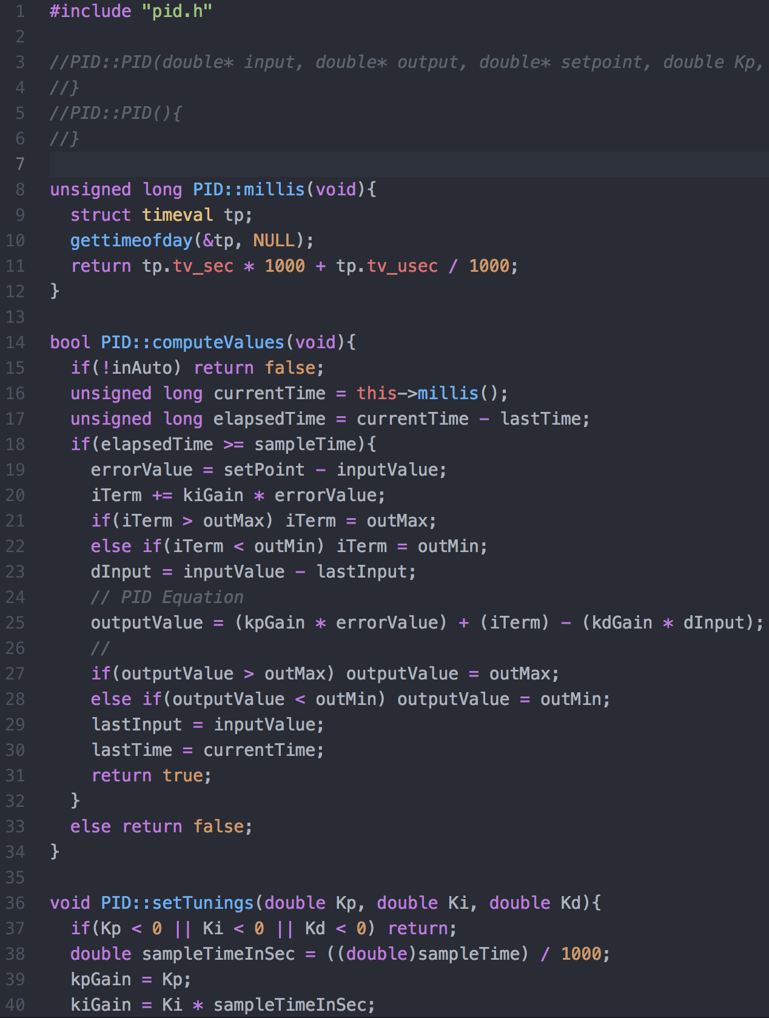
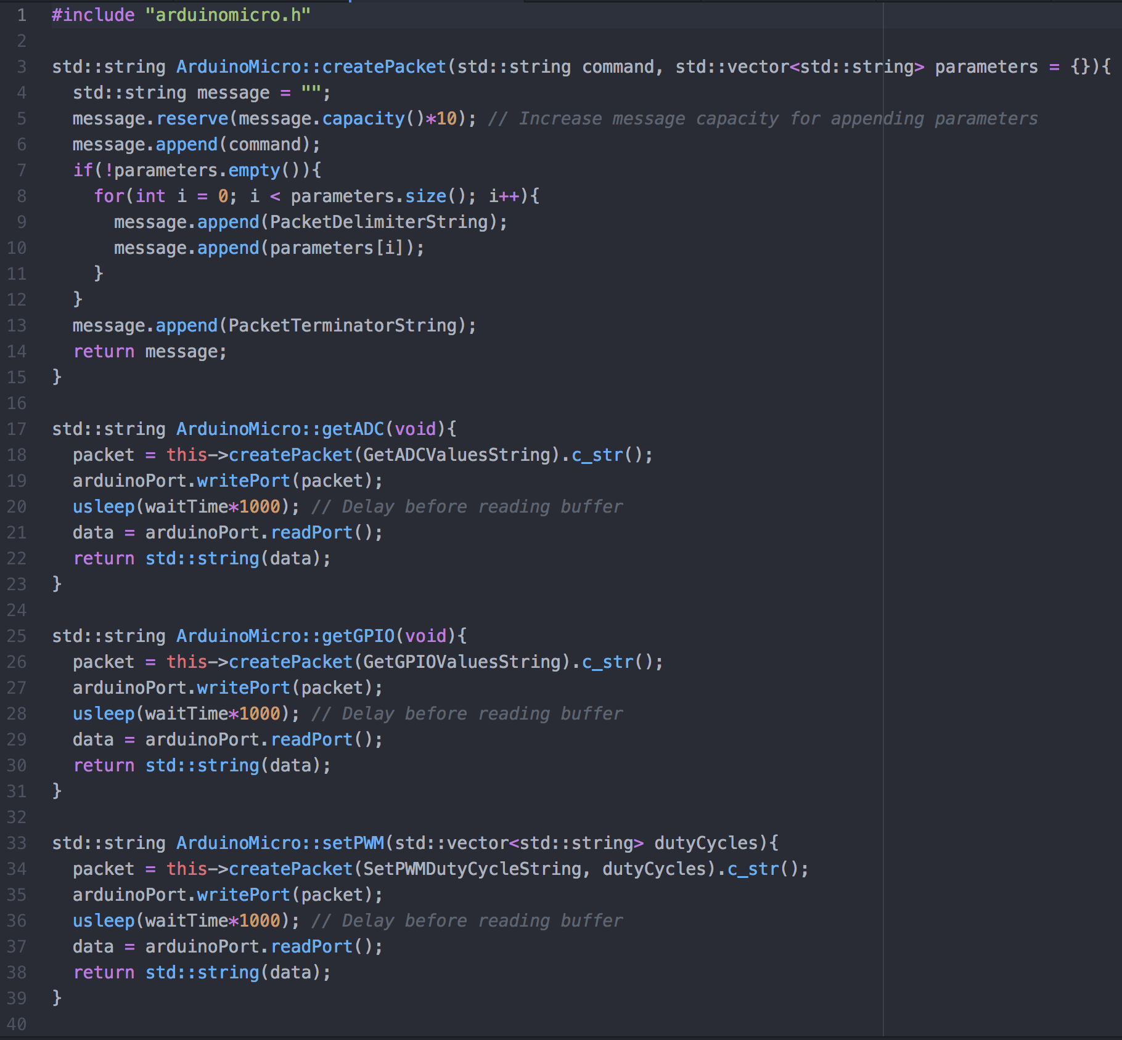
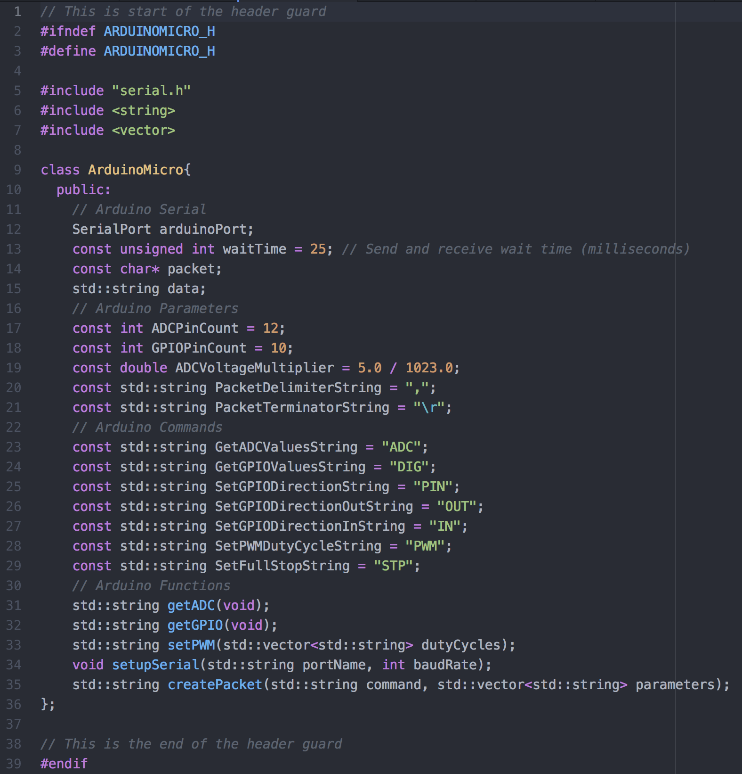
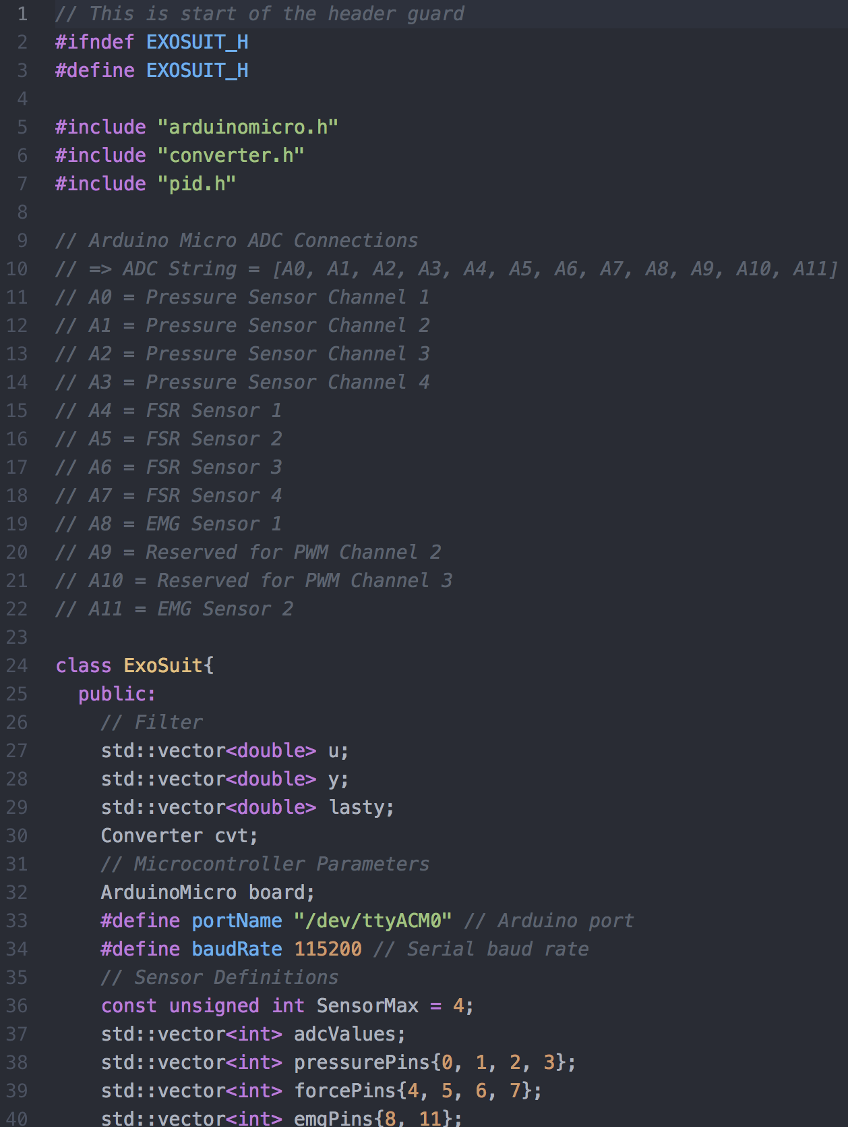
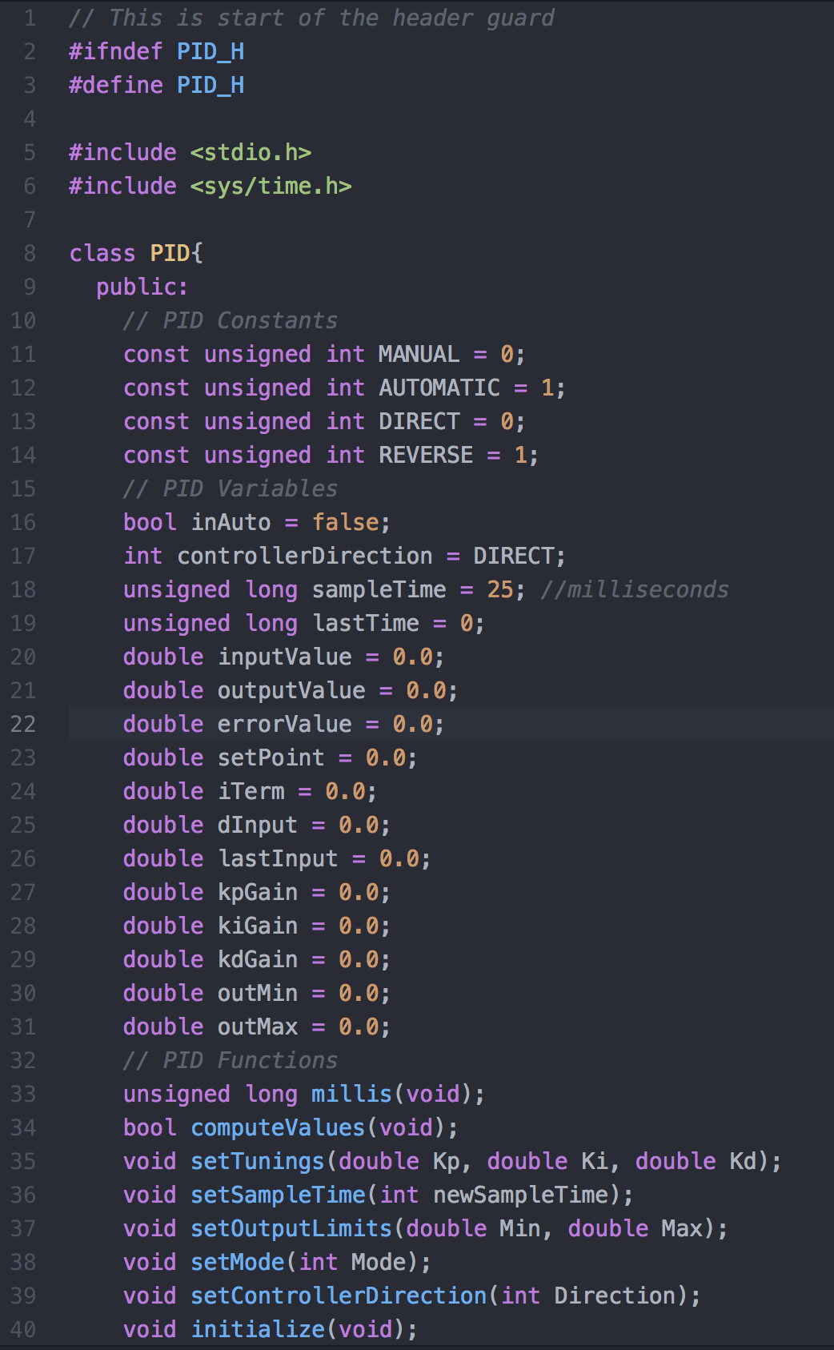
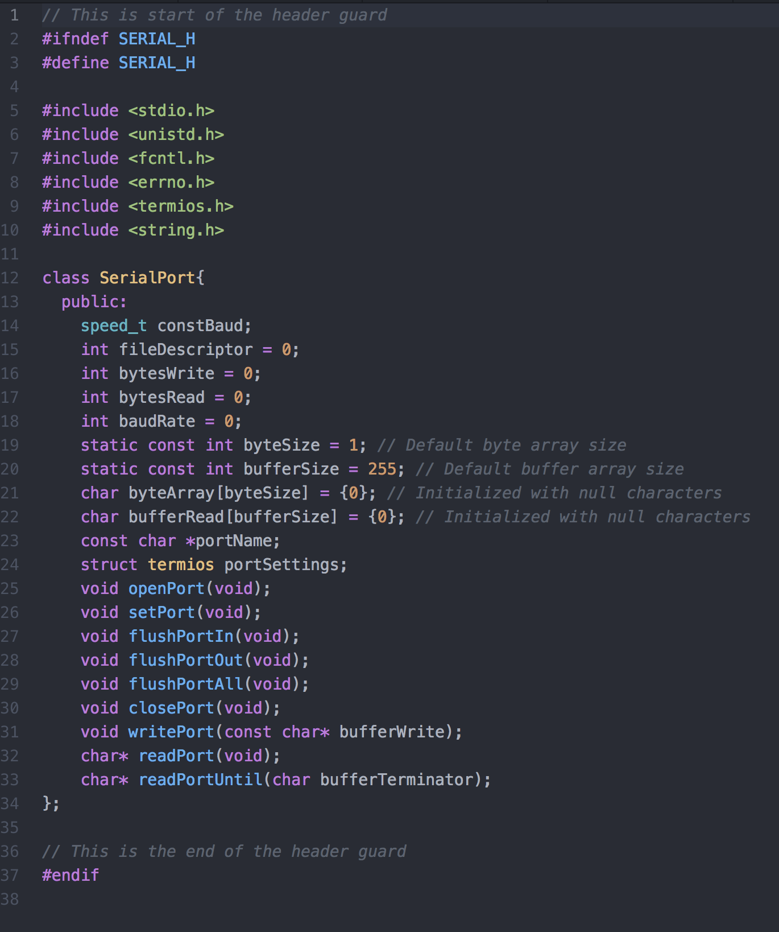
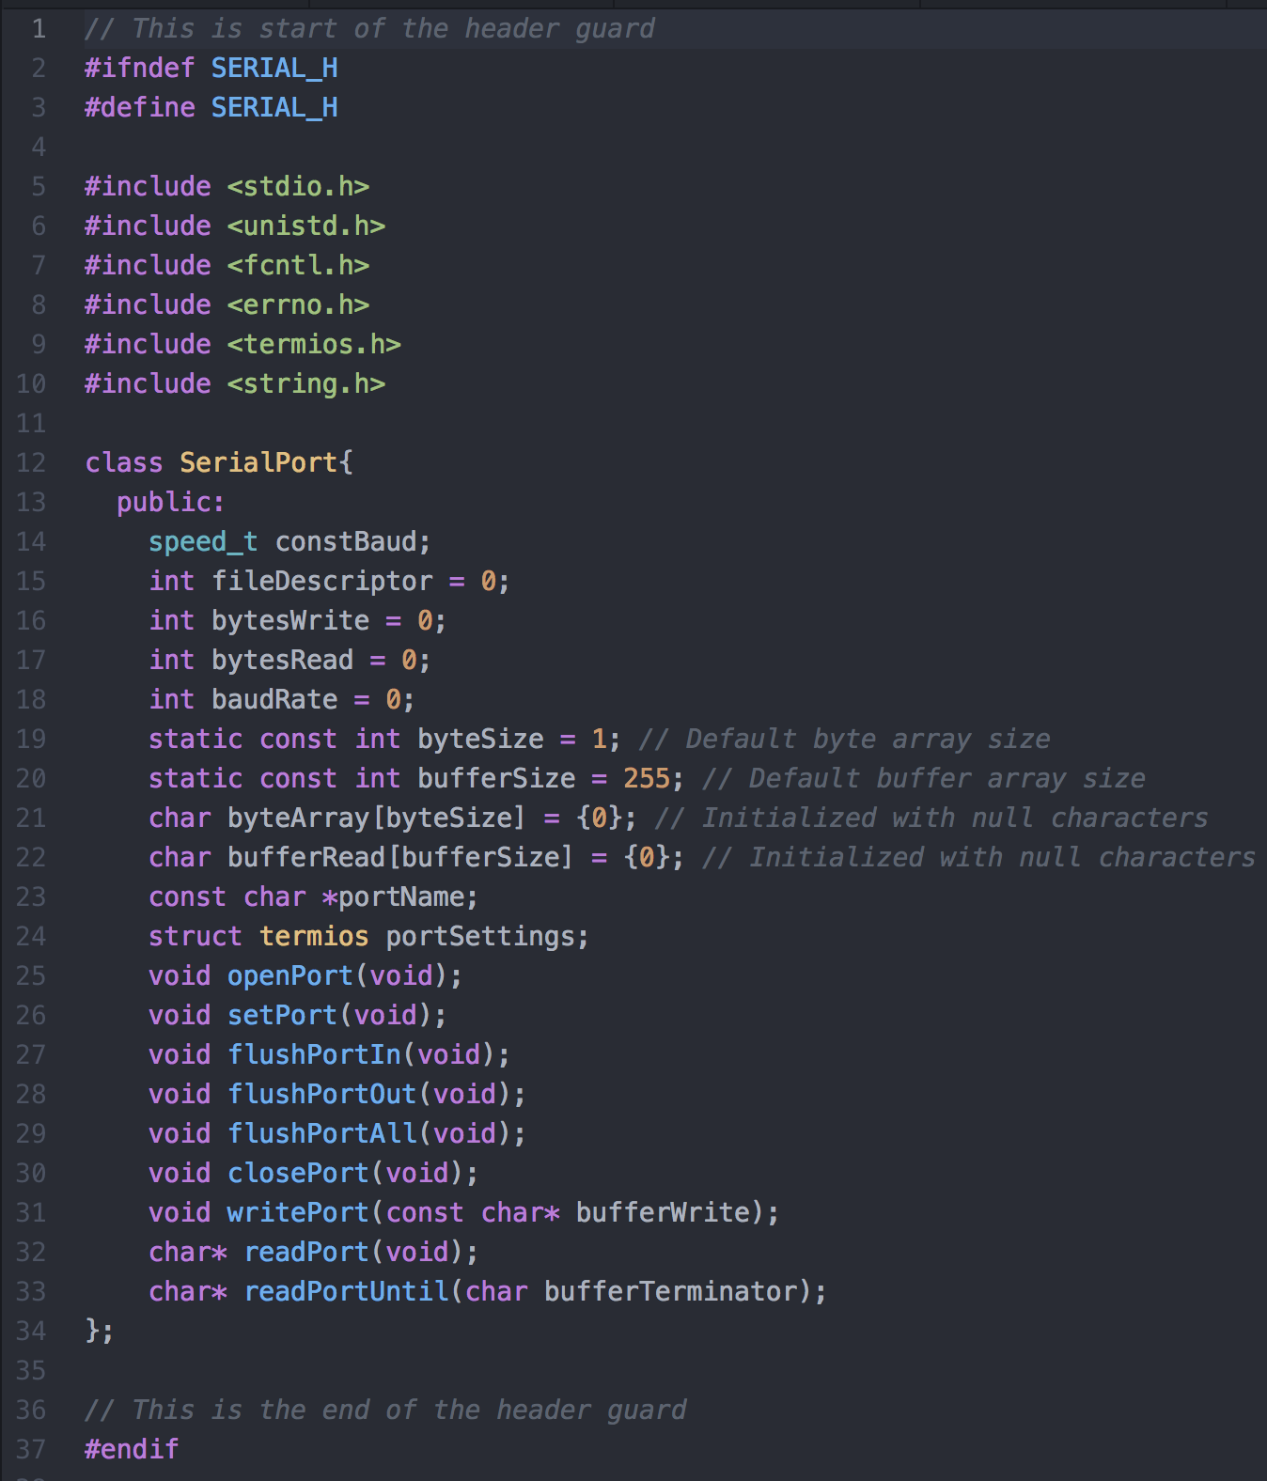
converter.cpp
converter.h
exosuit.cpp
pid.cpp
Feed into converter.cpp before
being pulled into exosuit.h
Feed into pid.cpp before
being pulled into exosuit.h
arduinomicro.cpp
arduinomicro.h
exosuit.h
Feed into arduinomicro.cpp before
being pulled into exosuit.h
pid.h
serial.cpp
serial.h
main.cpp
Feed into serial.cpp before
being pulled into arduinomicro.h

